Slide 1
Bar Beer Drinker
Suchitra Natarajan

Slide 2
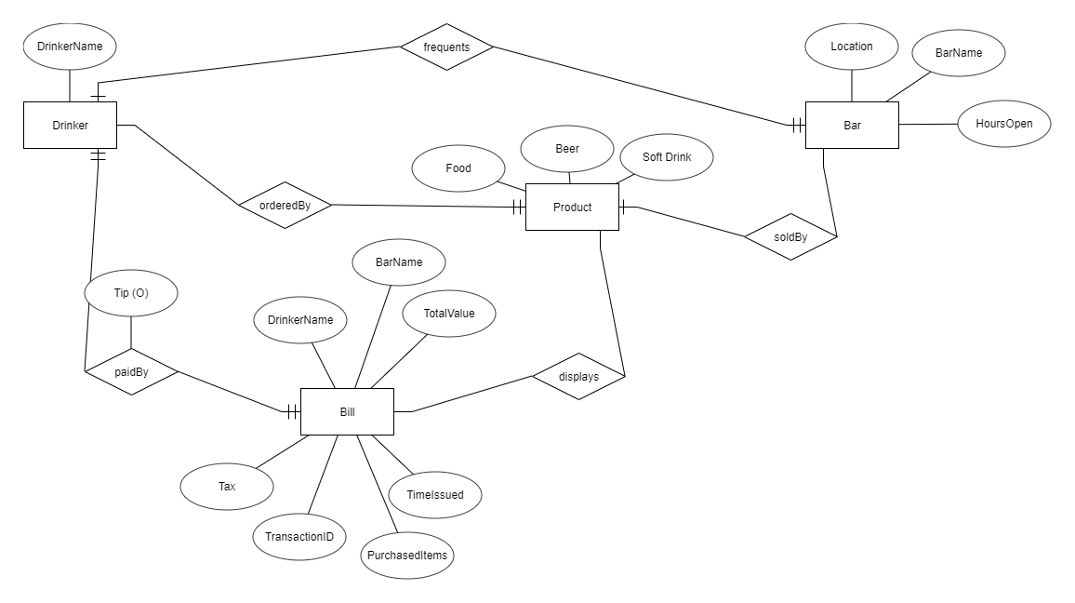
ERD Diagram

Slide 3
Drinker
- Name
Has value of name (later, address, phone, and cc number)
Pays the bill, orders Product, and frequents Bar – Can choose to leave optional tip

Slide 4
Bill
- DrinkerName
- BarName
- TotalValue
-Tax
-TransactionID
-PurchasedItems
-TimeIssued
Bill has all values, and is paid by Drinker, which displays the Product (can be food, beer, or soft drink). May have optional tip when paid by drinker

Slide 5
Product
-Food
-Beer
-Soft Drinks
Sold by bar, ordered by Drinker and can be displayed on Bill

Slide 6
Bar
-Location
-Name
-Hours open
Frequented by drinker, sells products

Slide 7
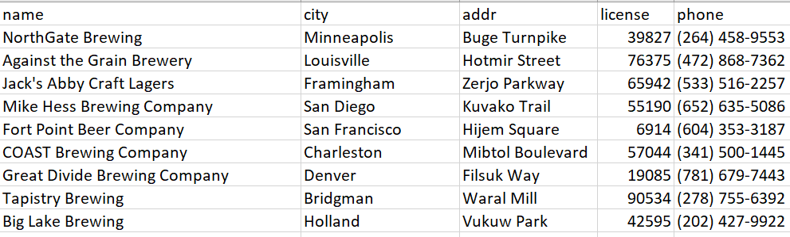
Bar Data
Taken from https://github.com/nickhould/craft-beers-dataset.git
Generated random street, address, phone, license, and city values

Slide 8
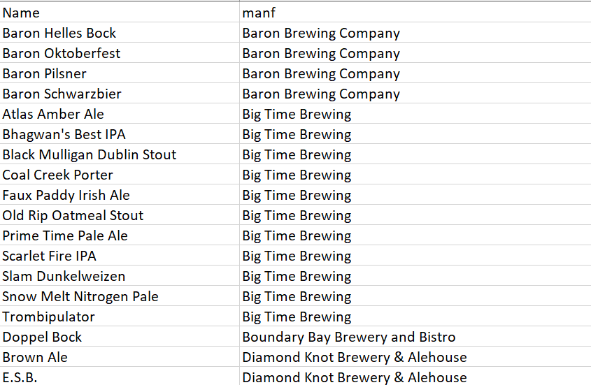
Beer data
Taken from https://github.com/beercsv/us-united-states.git
Associated the breweries from corresponding csv with manufacturer

Slide 9
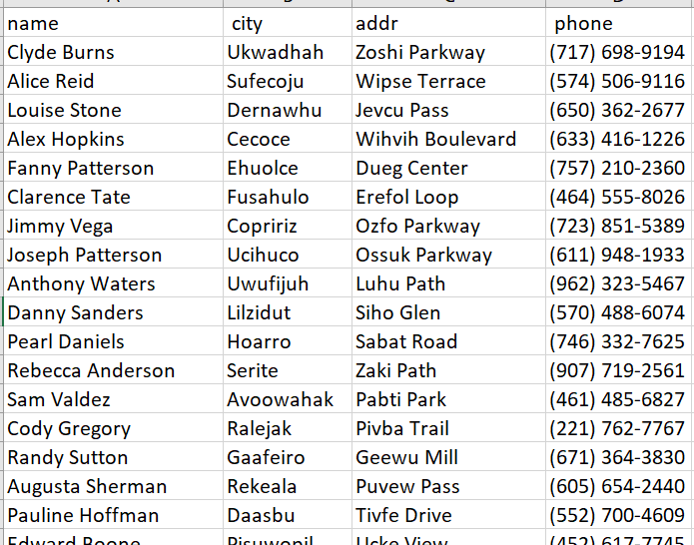
Drinker Data
Generated via http://convertcsv.com/generate-test-data.htm
Generated 5,000 name, address, phone, and city

Slide 10
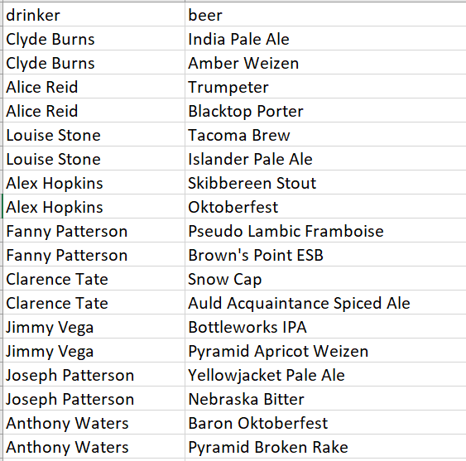
Likes
Generated through the drinker and beer
Chooses two random beers to associate with drinker

Slide 11
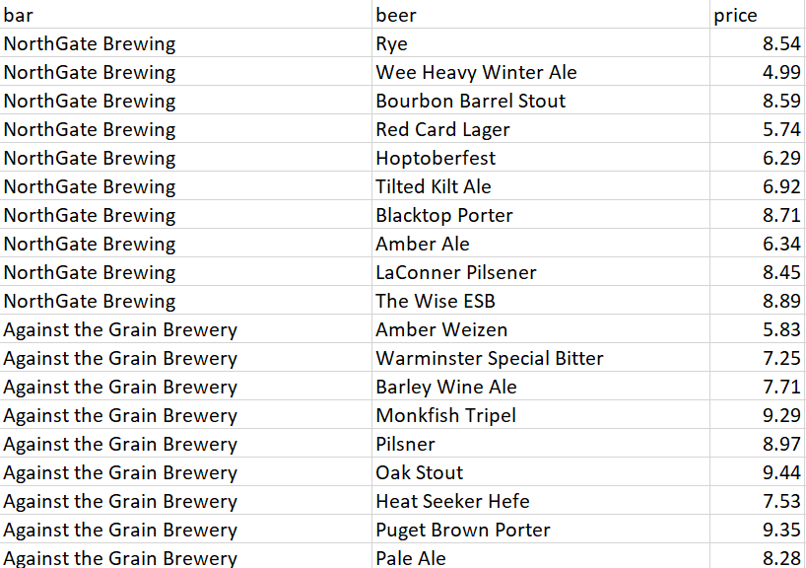
Sells
Generated through the bar and beer
Chooses ten random beers to be sold by bar and generates a price for them between 4.50 and 9.50

Slide 12
App
I used the skeleton app code from githhub
https://github.com/arpitshah101/BarBeerDrinker
Attached it to RDS:
Endpoint: cs336.ctkzi9h1lc8g.us-east-2.rds.amazonaws.com
Name: cs336
Password: password
Username: sucnat
Uploaded to Heroku at:
https://intense-ridge-26459.herokuapp.com/

